Slide 1
sw-precache and sw-toolbox
Automating the creation of a service worker
A better way to do Service Worker

Slide 2
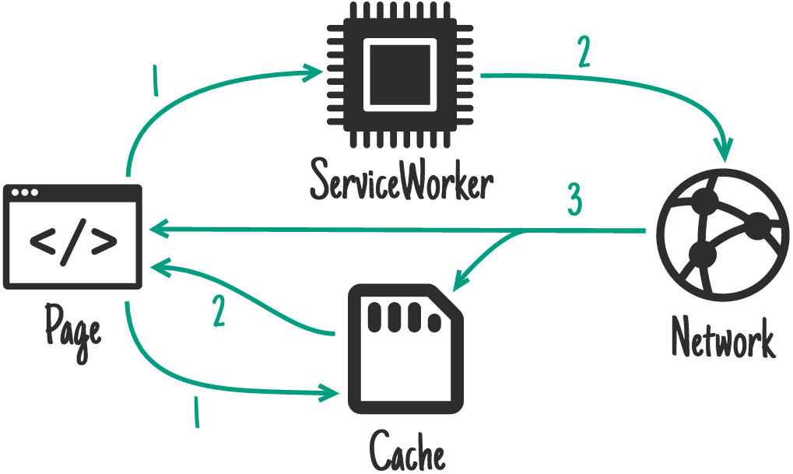







Service workers can be complex...
Notes:
Service worker implementation can be quite complicated, especially with larger projects.
There may be a number of files that need to be pre-cached and that hundreds of requests for different types of assets that all need to be handled differently.

Slide 3
The solution
sw-precache
sw-toolbox
Notes:
Google maintains two tools that make it easier to work with Service Worker and the Cache API.
These work well together to give you a really solid strategy for different types of caching for different resources in order to reduce network requests and make what you build work offline.
In combination, they work really well with the App Shell architecture that we describe elsewhere.
In a nutshell: we recommend you use sw-precache and sw-toolbox for your sites.
Even if you want to roll your own implementation, sw-precache and sw-toolbox are a great place to start.

Slide 4
sw-precache
Generate Service Worker code
Precache static resources so they work offline
Handle versioning, redirects, etc.
github.com/GoogleChrome/sw-precache
Notes:
sw-precache is a tool you add to your build process to generate a Service Worker file that will ensure that certain static resources are cached.
These resources are likely to be the core App Shell architecture components: index.html, main.css, main.js, your company logo — and so on.
It also gives you ways to implement different caching strategies for different resources.

Slide 5
sw-toolbox
Collection of helpers for writing your Service Worker
Caching strategies for dynamic content
Mapping caching strategies to application paths
Used extensively by sw-precache
github.com/GoogleChrome/sw-toolbox
Notes:
sw-toolbox mops up the rest.
You add code to your Service Worker that describes what files you want to cache — and the strategy you want to take.
Precaching every resource that a site needs to work offline isn’t feasible.
Some resources are too big or aren't used often enough, by all users, to make precaching feasible. Other resources are dynamic — such as the responses from a remote API or service.
Let's see how to get started.

Slide 6
Using sw-precache
Notes:
sw-precache generates a production ready service worker. You can specify resources for the service worker to cache on install.
There are many other options for configuring the generated service worker to accomplish whatever you need. We cover these options here.
Just a quick reminder:
• sw-precache is a Node module used to generate Service Worker code to precache specific resources so they get cached and work offline
• sw-precache can be used with JavaScript-based build systems like Gulp, or from the command line.
You can use the module directly, or if you'd prefer, use of the wrappers around sw-precache for specific build environments, like webpack.
It works well with the sw-toolbox library, which works well when following the App Shell + dynamic content model.

Slide 7
Add sw-precache to Gulp
var path = require('path'); var swPrecache = require('sw-precache');
var paths = { src: 'app/' };
gulpfile
Notes:
In a production system we want our tools to handle building the service worker with sw-precache and add the service working generation task.
In this example, we add sw-precache to our default gulp task so it will run every time we do work in the application.
In this section we’ll cover how to automate the process by adding a generate-serviceworker task to a Gulp workflow.
The first thing to do is to tell Gulp what plugins to use.
Because Gulp must know what plugins to use we register each plugin to a variable by assigning a require statement for each of the plugins we use. In this case we add `path` and swPrecache to the list of plugins at the top of the build file:
var path = require('path');
var swPrecache = require('sw-precache');
Create an array of variables to reflect the paths used in our application. Right now the code we only uses only a `src` child to represent the root directory of the application.
var paths = {
src: 'app/'
};

Slide 8
Create the gulp task
gulp.task('generate-sw', callback => {
swPrecache.write(path.join(paths.src, 'sw.js'), {
staticFileGlobs: [ details follow ] // 1
importScripts: [ details follow ] // 2
stripPrefix: paths.src // 3
}, callback);});
gulpfile
Notes:
The service-worker task takes the static elements we want to cache for our application shell. We tell the gulp task what files we want to cache in the staticFileGlobs section (marked as 1) and what files to import in the importScripts section (marked as 2.) The scripts imported will be used by sw-toolbox.
Strip the root prefix (3) to turn the element into a relative path. If we do not strip the source prefix we would be working with absolute paths. Absolute paths are written different in Windows (c:\directory) and Macintosh/Linux (/directory).

Slide 9
1: List the file patterns to precache
staticFileGlobs: [
paths.src + 'index.html',
paths.src + 'js/main.js',
paths.src + 'css/main.css',
paths.src + 'img/**/*.{svg,png,jpg,gif}'
],
gulpfile
Notes:
The service-worker task takes the static elements we want to cache for our application shell. We tell the gulp task what files we want to cache in the staticFileGlobs section (marked as 1).

Slide 10
2: Scripts used by the generated code
importScripts: [
paths.src + '/js/sw-toolbox.js',
paths.src + '/js/toolbox-scripts.js'
],
gulpfile
Notes:
The service-worker task takes the static elements we want to cache for our application shell. We tell the gulp task what files we want to cache in the staticFileGlobs section (marked as 1) and what files to import in the importScripts section (marked as 2.) The scripts imported will be used by sw-toolbox.

Slide 11
Run Gulp
$ gulp generate-sw
Notes:
Now we can run Gulp to generate the service worker.

Slide 12
Using sw-precache from the command line
Notes:
sw-precache generates a production ready service worker. We can specify resources for the service worker to cache on install.
There are any other options for configuring the generated service worker to accomplish whatever you need. We cover these options here
Reminder:
sw-precache is a Node module used to generate Service Worker code to precache specific resources so they work offline
sw-precache can be used with JavaScript-based build systems like Gulp, or from the command line.
You can use the module directly, or if you'd prefer, use of the wrappers around sw-precache for specific build environments, like webpack.
It works well with the sw-toolbox library, which works well when following the App Shell + dynamic content model.

Slide 13
Create a configuration file
{
"staticFileGlobs": [ "app/index.html", "app/js/main.js", "app/css/main.css", "app/img/**/*.{svg,png,jpg,gif}" ], "stripPrefix": "app/"
}
sw-precache-config.json
Notes:
There may be times when you want to test the result of using sw-precache and don’t want to have to change your build system for every version of the experiment. sw-precache allows you to use the tool from the command line.
We will first create a `sw-precache-config.json` file with our sw-precache configuration. In this example staticFileGlobs indicates the path to each file we want to precache (or a glob to match multiple files in the case of images) and stripPrefix tells sw-precache what part of each file path to remove.

Slide 14
Run sw-precache from the command line
$ sw-precache --config=path/to/sw-precache-config.json
Notes:
Once the sw-precache configuration is ready we run it with the following command:
$ sw-precache --config=path/to/sw-precache-config.json --verbose
You can use --config to get the location of sw-precache-config.json, or add a --verbose flag to provide additional information.

Slide 15
sw-toolbox
Notes:
sw-toolbox provides Service Worker tools for caching assets from runtime requests.

Slide 16
In your service worker...
Specify the caching strategy for each route in your app:
toolbox.router.get('/app/index.html', toolbox.networkFirst);
Notes:
sw-toolbox simplifies the creation and customization of caching rules and strategies. At its simplest, sw-toolbox creates one or more routes.
Routes match request URL patterns and route them to the specified handler.
We start each route with "toolbox.router".
We can then specify an HTTP method to match. This can be GET, POST, PUT, DELETE or HEAD.
The first argument after the HTTP method is the URL pattern. This can be written using Express-like syntax or a regular expression (more on this in the next slide).
The second argument is the request handler. This can do anything we choose. In this case we've used the built-in "network first" strategy for requesting and caching resources (more on that later).
There is an optional third parameter, the "options" object, that lets us specify some options for the route. Most of these options give us more control over the cache for that route.
The example defines a route using the get HTTP verb, matching the pattern `/app/index.html` and using a network first handler (it will fetch the resource from the network first and fall back to the cache if the network is not available).

Slide 17
sw-toolbox caching strategies
toolbox.networkFirst
toolbox.cacheFirst
toolbox.fastest
toolbox.cacheOnly
toolbox.networkOnly
Notes:
sw-toolbox provides five handlers for responding to route requests.
toolbox.networkFirst Try to fetch the resource from the network and store the response in the cache if successful. Otherwise try to fetch resource from cache. This is the strategy to use for basic read-through caching. It's also good for API requests where you always want the freshest data when it is available but would rather have stale data than no data. toolbox.cacheFirst If the request matches a cache entry, respond with that. Otherwise try to fetch the resource from the network. If the network request succeeds, update the cache. This option is good for resources that don't change, or have some other update mechanism. toolbox.fastest Request the resource from both the cache and the network in parallel. Respond with whichever returns first. Usually this will be the cached version, if there is one. This strategy will always make a network request, even if the resource is cached. However, if/when the network request completes the cache is updated, so that future cache reads will be more up-to-date. toolbox.cacheOnly Resolve the request from the cache, or fail. This option is good for when you need to guarantee that no network request will be made, for example saving battery on mobile. toolbox.networkOnly Handle the request by trying to fetch the URL from the network. If the fetch fails, fail the request. Essentially the same as not creating a route for the URL at all.

Slide 18
URL pattern-matching
Express-like
Regular expression
Notes:
We can use one of two pattern-matching languages to write our URL patterns.
These languages let us to match wildcards in our patterns. They also let us match requests from different domains.
Note:
If you're matching a single same-origin URL, a simple string will work.

Slide 19
Express-like Routing
toolbox.router.get('/(.*)', global.toolbox.cacheFirst, { origin: /\.googleapis\.com$/ }); toolbox.router.get('/.*fly$/', global.toolbox.cacheFirst);
Notes:
If you’re familiar with Express.js you can create routes with a syntax similar to its routing syntax.
If the URL pattern is in string quotes it is assumed you're using Express-style routing.
To match requests from a different origin using Express-style routing, we must specify the origin in the "origin" parameter of the options object.
In the first example we intercept all get requests to googleapis.com and use the cache first strategy: If the reponse is in the cache we return it. If it isn't, we fetch it from the network and add it to the cache.
The pattern in the second example intercepts all get requests ending in fly, like butterfly and dragonfly. For all the requests it matches, the route uses the cache first strategy.

Slide 20
Regular Expression Routing
toolbox.router.get(/index.html$/, function(request) { return new Response('Handled a request for ' +
request.url); }); toolbox.router.post(/^https://api.flickr.com\//,
global.toolbox.networkFirst);
Notes:
If you’re more comfortable working with regular expressions you can use them to define routes. Pass a RegExp object as the first parameter of the route. This RegExp will be matched against the full URL (request and path) to determine if the route applies to the request. This matching makes for easier cross origin routing since the origin and the path are matched at the same time without having to specify an origin separately like we did with Express style routes.
To use a regular expression in the URL pattern, do not wrap the URL in quotes.
The route in example 1 will handle all requests that end with index.html, regardless of how deep into your application structure the route finds the match. Notice we have defined a custom handler for the request.
The second example will handle all request that begin with https://api.flickr.com/ using a network first strategy. This will ensure that your app gets the freshest content possible but will still get some content if you are offline.

Slide 21
Managing the cache
toolbox.router.get('/(.*)', global.toolbox.cacheFirst, { cache: { name: 'googleapis', maxEntries: 10, maxAgeSeconds: 86400 },
origin: /\.googleapis\.com$/ });
Notes:
sw-precache also gives us the ability to control the cache and its characteristics. We can define a "cache" parameter in the options object.
In the example:
The Express route handles requests ending with googleapis.com using the cache first strategy. In addition to handling the origin we customize the cache itself:
We give it a name (googleapis)
We give it a maximum size of 10 items (indicated by the maxEntries parameter)
We set the content to expire 86400 seconds (24 hours)
Whenever there are more than 10 items in the cache, the oldest items will be purged to make room for the new. Content will also be expired after 24 hours (86400 seconds)

Slide 22
Remember to load the toolbox
service worker
importScripts("./node_modules/sw-toolbox/sw-toolbox.js",
"./js/toolbox-script.js");
Notes:
To use sw-toolbox you include the sw-toolbox module in your service worker along with a custom script containing the routes.

Slide 23
Lab Overview
npm install both sw-toolbox and sw-precache
Create a Gulp task to generate the service worker
Write a toolbox script to intercept specific requests
Use sw-precache from the command line

